Slide 1
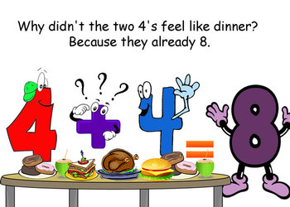
Number
Term 1
Semester 1
Teacher:
Class:

Slide 2
Contents
Glossary or Formula Page
Page
Date
Description
2
3

Slide 3
Tasks
24
7
30
Essential Question
Questions
Notes
Summary
4
5

Slide 4

24
7
30
Topic: BIMDAS
Date
Essential Question:
How do we use BIMDAS?
Questions
Notes:
Example :
$8+96 ÷2=$
$10 −4^{2}÷8$ =
$7^{2 }÷(4+3)$ =
What are the rules of BIMDAS?
Also known as ‘order of operations’
1. Brackets First
2. Indices
3. Multiply and/or Divide
(from left to right)
4. Add or Subtract
(from left to right)
5

Slide 5
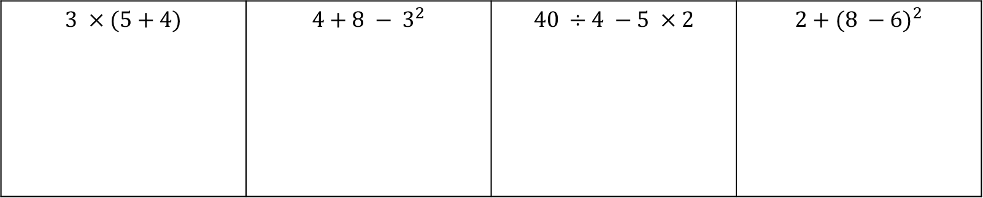
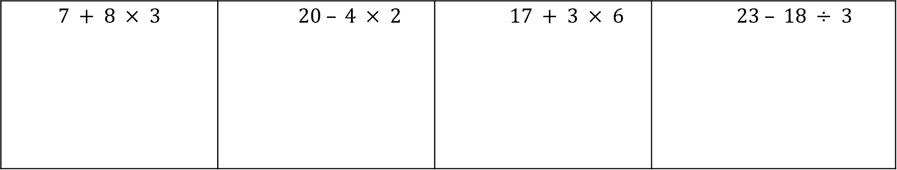
Left-hand side
$$7 + 8 × 3$$ | $20 – 4 × 2$ | $17 + 3 × 6$ | $$23 – 18 ÷ 3$$
$$3 ×(5+4)$$ | $$4+8 − 3^{2}$$ | $$40 ÷4 −5 ×2$$ | $$2+{(8 −6)}^{2}$$

Slide 6
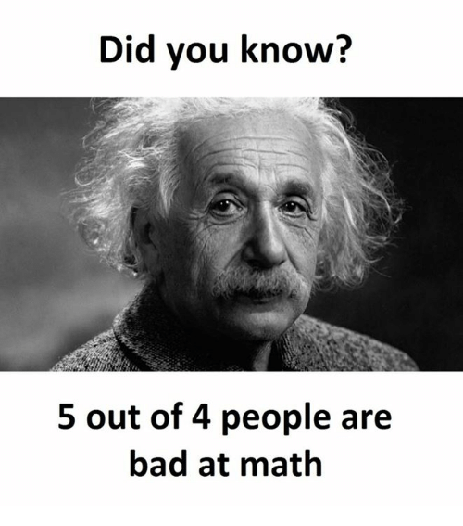
WORKSHEET
COMPLETED
GLUE onto Left hand side

